Slide 1
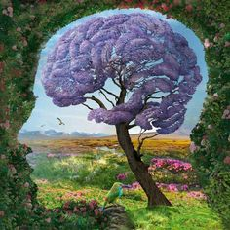
How To Find
Your Creative Mind:
Using NEURO-Science
To Enhance Your Creativity
By Michael Baldwin, MLS, MPA

Slide 2

How To Find Your Poetic Mind:
Using NEURO-Science
and mysticism
To Enhance Your Creativity
by Michael Baldwin, MLS, MPA &
Marilyn Gilbert Komechak, PhD

Slide 3
Part One
Using Neuro-Science To Optimize Your Creative Potential

Slide 4
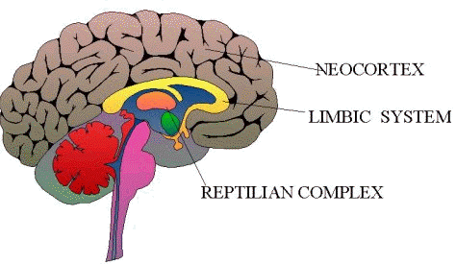
Neuro-science is the study of the structure and operation of the brain.
Brain Structure:
The human brain is really composed of three brains that operate cooperatively:
  The reptile brain, that takes care of basic bodily functions like breathing, blood circulation, hormone release, etc. And energizes the body for fight or flight if a threat is perceived.
  The Limbic or mammalian brain, which governs most of our emotional responses to external stimuli.
  The new brain (Neocortex), where our higher order thinking occurs (but most of it still below consciousness).

Slide 5
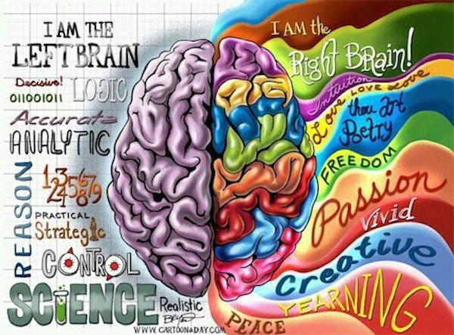
The neocortex is divided into two hemispheres with different functions:
  The left side is more verbal, logical, analytical, and mathematical. It operates in a linear, sequential manner. Most traditional educational methods are based on left brain functions. The left brain seeks order and logic.
  The right side is non-verbal, dealing more with image, color, rhythm, intuition, imagination, spatial relations, and operates in a rapid, holistic, pattern-seeking, multi-faceted manner. The right brain enjoys complexity, ambiguity, paradoxical divergence of thought.

Slide 6
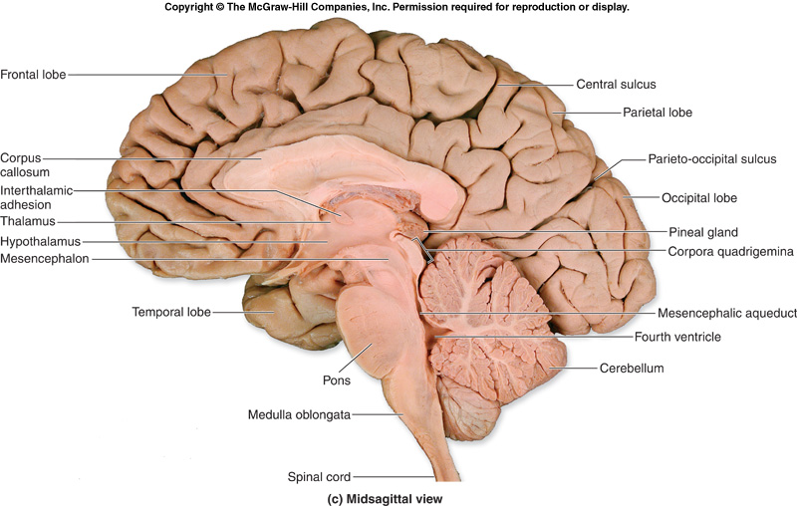
Let’s make sure we understand the difference between the brain and the mind. The brain is the physical matter in our heads: 3 pounds of meat composed of billions of neurons that constantly transmit chemical and electrical signals among themselves and receive signals from other parts of the body.

Slide 7
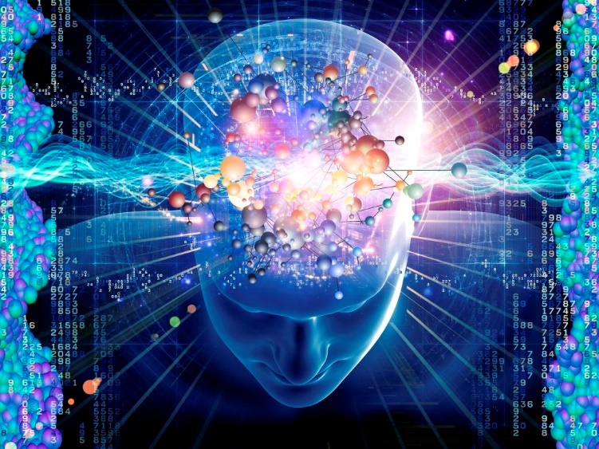
The mind or consciousness consists of our thoughts, memories, emotions, and sensory impressions, which depend on the physical brain for processing and storage. Using a computer metaphor, the brain is our hardware and the mind is our software and its activity.

Slide 8
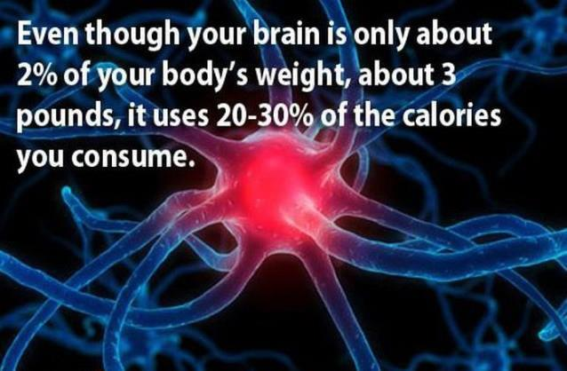

Slide 9
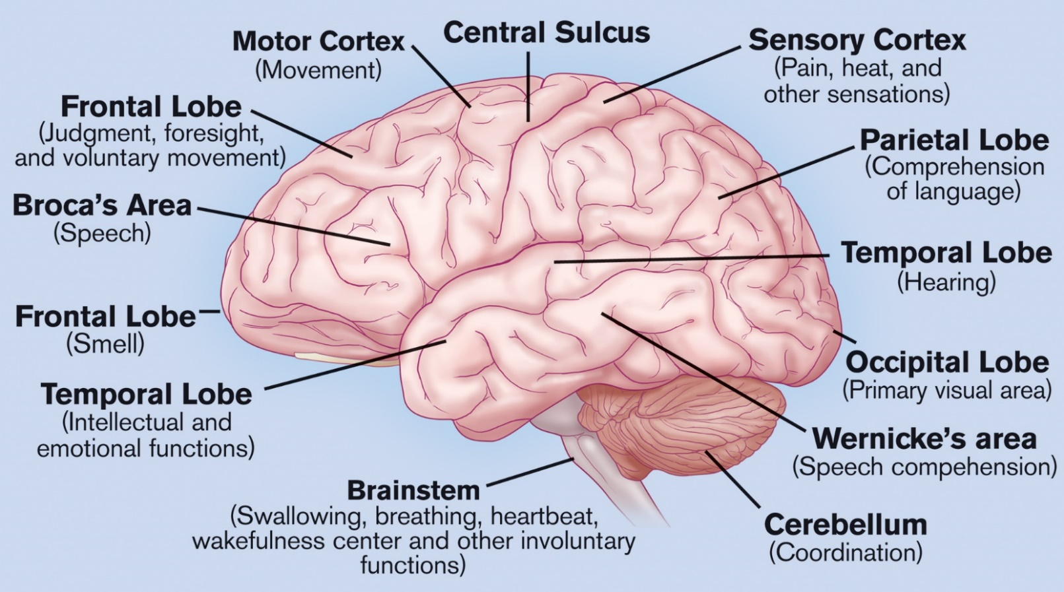
Basic idea: It is the brain that generates the mind, but
it is the mind, not the physical brain, that is rational and/or creative.
To make the mind more creative, we must manipulate the brain in various ways.
We will discuss how best to manipulate the brain later.

Slide 10
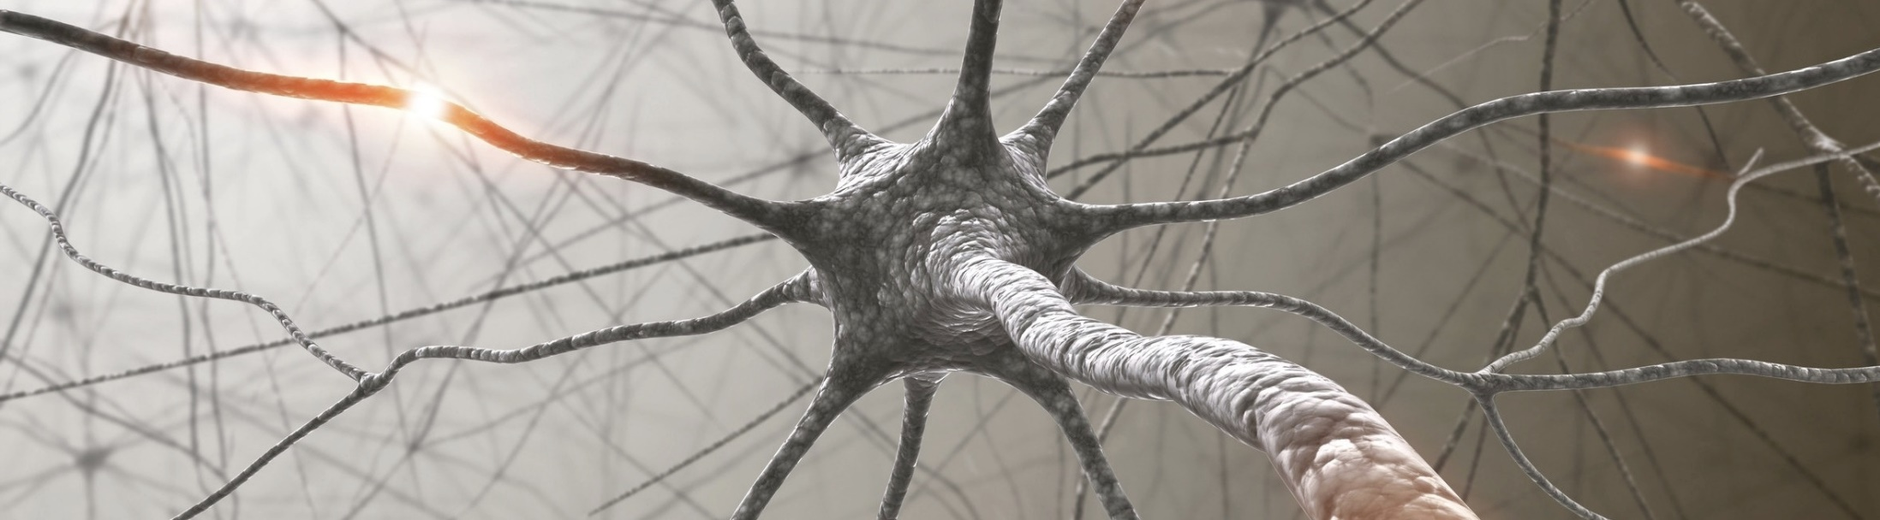
Brain activity that affects the mind is of two kinds:
Electrical waves of several kinds.
Chemicals of many kinds called neurotransmitters.

Slide 11
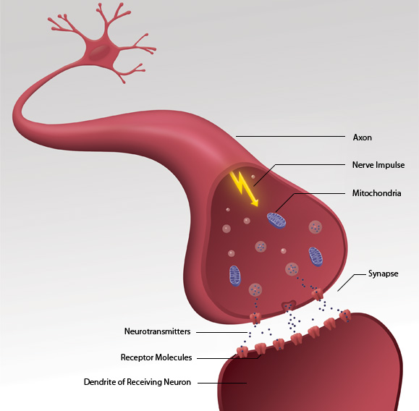
Diagram of two neurons communicating between their synaptic gap with neurotransmitters and electrical waves.

Slide 12

The mind is often multi-tasking on both conscious and sub-conscious levels. It is regulating your temperature, blood pressure, ext. sub-consciously, while you may be consciously accessing a memory, driving a car, and singing along with the radio, or just day-dreaming.

Slide 13
The brain is able to multi-task because it is constantly producing both brain waves and neurotransmitters. Different areas of the brain may be generating waves and chemicals of different types and strengths at the same time, thus allowing several physical and mental activities at the same time.
Let’s first take a look at the different types of brain waves.

Slide 14
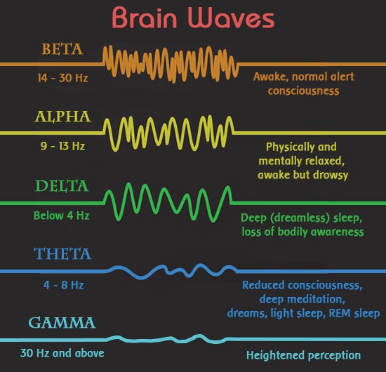

Slide 15
Beta (12-30Hz): Beta brain waves are associated with:
normal waking consciousness and a heightened state of alertness,
logic and critical reasoning,
normal daily activities. But
higher Beta levels translate into stress, anxiety and restlessness.

Slide 16
Alpha (7.5-12Hz): Alpha brain waves are present in:
deep relaxation with the eyes usually closed and while day-dreaming.
Alpha is relaxed detached awareness achieved during light meditation. And,
Alpha heightens your imagination, visualization, memory, learning and concentration.
Alpha lies at the base of your conscious awareness and is the gateway to your subconscious mind.
Alpha is your intuition, which becomes clearer and more profound the closer you get to 7.5Hz.

Slide 17
Theta (4-7.5Hz): Theta brain waves are present:
during deep meditation and light sleep, including the REM dream state.
Theta is the realm of your subconscious mind.
Theta is also known as the twilight state as it is normally only momentarily experienced as you drift off to sleep (from Alpha) and arise from deep sleep (from Delta).
A sense of deep spiritual connection and oneness with the Universe can be experienced at Theta.
Vivid visualizations, great inspiration, profound creativity, exceptional insight as well as your mind’s most deep-seated programs are all at Theta.

Slide 18
Delta (0.5-4Hz): The Delta frequency:
is the slowest and is present in deep, dreamless sleep,
and in very deep, transcendental meditation where awareness is completely detached.
Delta is the realm of your unconscious mind.
Delta is associated with deep healing and regeneration, underlining the importance of deep sleep to the healing process.

Slide 19
Gamma (30-100Hz): Gamma waves are:
The most recently discovered range of brain waves.
The fastest in frequency at above 40Hz (some researchers do not distinguish Beta from Gamma waves).
Little is known about this state of mind, but,
initial research shows Gamma waves are associated with bursts of insight and high-level information processing.

Slide 20
Neuroimaging studies have indicated that:
the brain produces all the types of waves almost all the time, but in varying amounts, so one is usually predominant.
Also, different parts of the brain can produce different waves at different times. This is important for the creative mind application.
Experienced meditators can put their minds into a combination Alpha/ Theta state in which they can watch their thoughts without emotion or interaction. This state is very beneficial in terms of relaxation, mental health, and for creative consciousness.

Slide 21
Now we have enough information about how the brain works to talk about the mind, and how to make it more creative. What do we know about creativity?

Slide 22
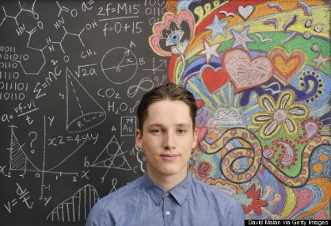
Neuroscientists are finding out many new things about how our brains operate, both in ordinary life and in creative functioning. Here are three basic ideas that scientists have found about the mind:
Our creative minds are very different from our rational minds.

Slide 23

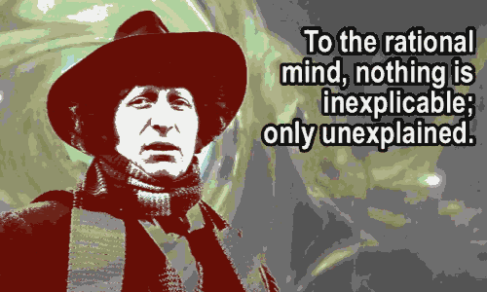
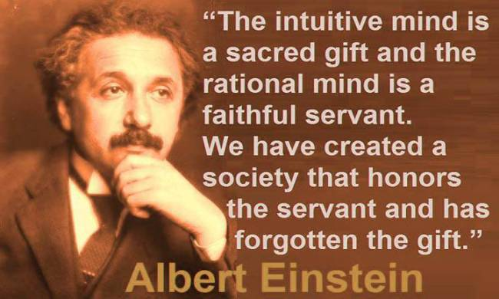
The Rational vs the Intuitive (Creative) mind

Slide 24
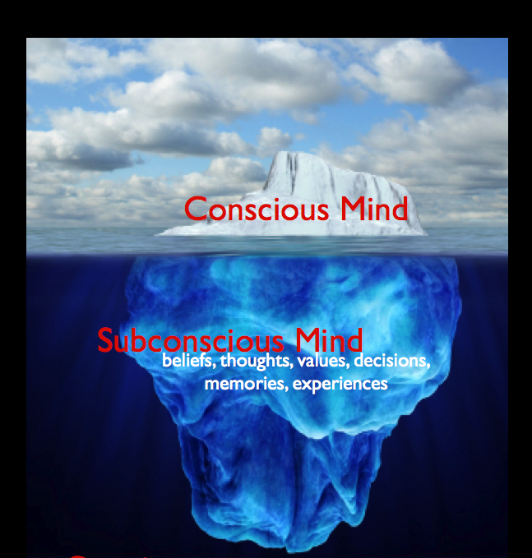
  Most of our thought processes are subconscious (95% +); we are not aware of how or why most of our ideas come to us.

Slide 25

  We think most effectively when our rational and creative minds operate cooperatively and simultaneously.

Slide 26
We use both sides of our brain constantly, but usually one side dominates over the other depending on the type of thinking being done.
Furthermore, our American culture tends to emphasize the rational, linear, left brain more than the intuitive, holistic right brain.
So our creative right brain is often less developed.

Slide 27
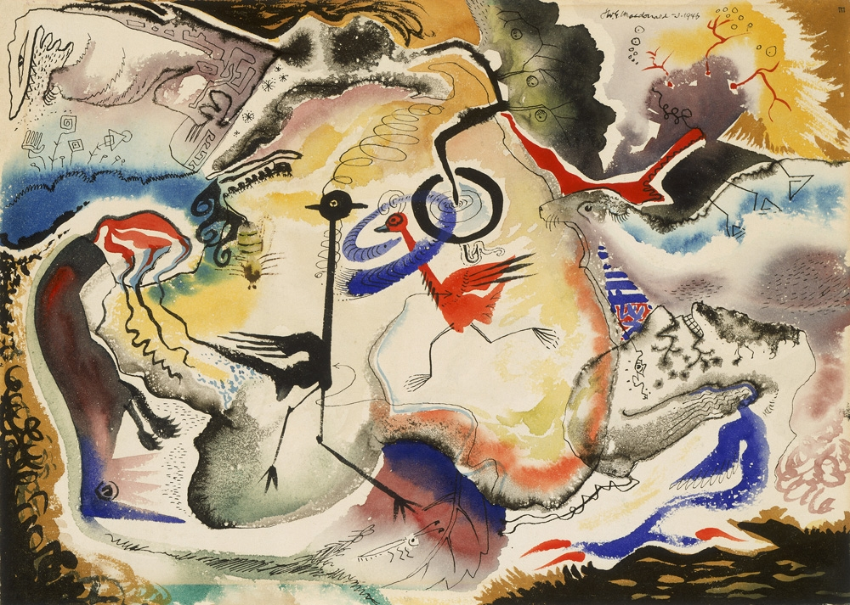
Could our rational mind create this image?

Slide 28


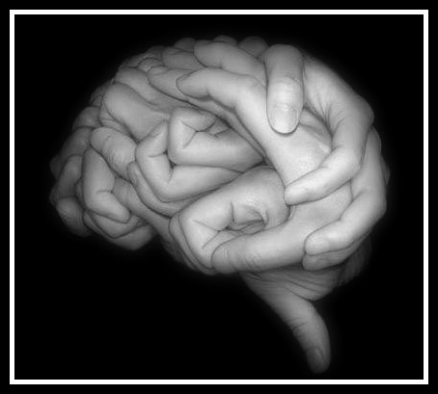
Or
Our hands can tell us if we are dominant in left or right brain.

Slide 29
Put your hands together in the most comfortable way for you.
If your right thumb is on top of your left, you are primarily left brained.
If you left thumb is on top, you are primarily right brained.

Slide 30
Sometimes our left and right brains actually work against each other. Here’s a simple demonstration of the two brains in conflict:

Slide 31
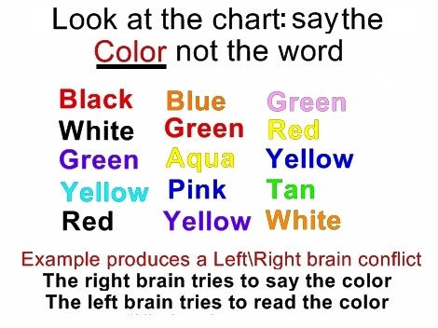

Slide 32
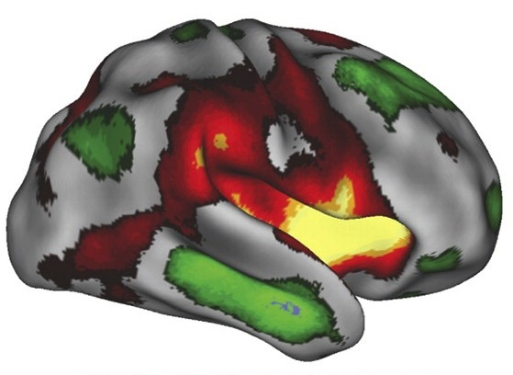
Evidence from the latest research into brain function suggests that the left brain-right brain dichotomy is too simple. There is no major function that happens strictly in one side or the other. Most functions are widely distributed in various regions in both hemispheres, as illustrated below. Creativity occurs in both hemispheres.

Slide 33
However, we can continue to use the concepts of the left-brain, right-brain dichotomy to keep the discussion simple for the practical purposes of discussing creativity.
What we emphasize here is the need to make all areas of the brain work together effectively to enhance our creativity.
Here is what some famous poets have said about how their minds work when engaging in creative activity:

Slide 34
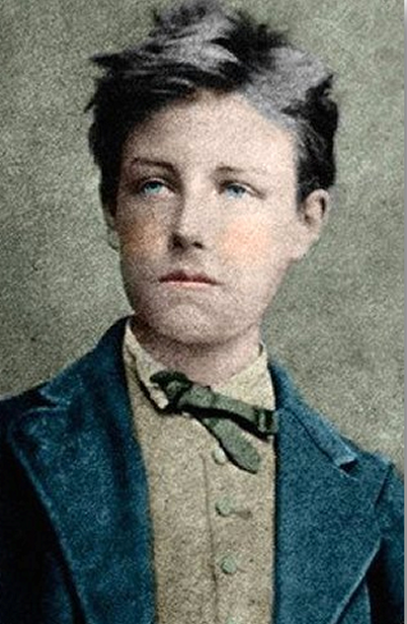
“The Poet makes himself a seer by a long, gigantic and rational derangement of all the senses.”
Arthur Rimbaud
1854-1891

Slide 35
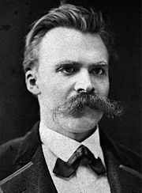
“One must still have chaos within oneself to give birth to a dancing star.”
Friedrich Nietzsche

Slide 36
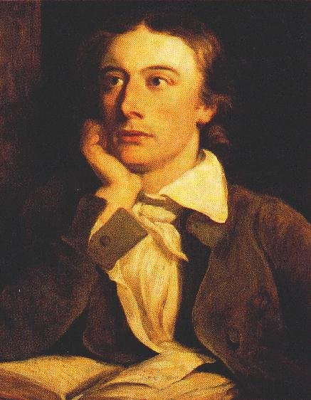
“Negative capability, that is when man is capable of being in uncertainties, Mysteries, doubts, without any irritable reaching after fact and reason.”
John Keats
1795-1821

Slide 37
But you don’t need to resort to alcohol, drugs, or mental derangement to be creative.
I will list and illustrate some easy, practical ways the brain can be stimulated to function for enhanced creativity:

Slide 38
The neurotransmitter serotonin provides your right brain a sense of calm and contentment that it needs for optimum creativity.
Your left brain is more creative when another neurotransmitter, dopamine, moves you from boredom or apathy to excitement and engagement.
The best neurochemical cocktail for your most creative work is a high level of both serotonin and dopamine. This will produce a condition in which you are calm but also energized.

Slide 39
You can promote the production of serotonin and dopamine in several ways:
Reduce stress as much as possible. Stress produces cortisol, which reduces serotonin and dopamine.
Get 6 to 8 hours of high quality, deep sleep. This helps generate serotonin, which will then be highest in the morning.
Because serotonin is highest in morning hours, that may be the best time to do your creative work.
Eat a high-protein breakfast rather than carbohydrates. Protein helps produce both serotonin and dopamine.
Stimulate serotonin production and energy thru physical exercise and perhaps the mild stimulant of coffee or tea.

Slide 40
Although serotonin & dopamine may be naturally high in the morning, you may want to be more creative in afternoon or evening.
Anytime is good for creativity if you can free yourself from stress, be relaxed but alert, and are ready to be creative.
Here are some additional things you can do to prepare for creativity:

Slide 41
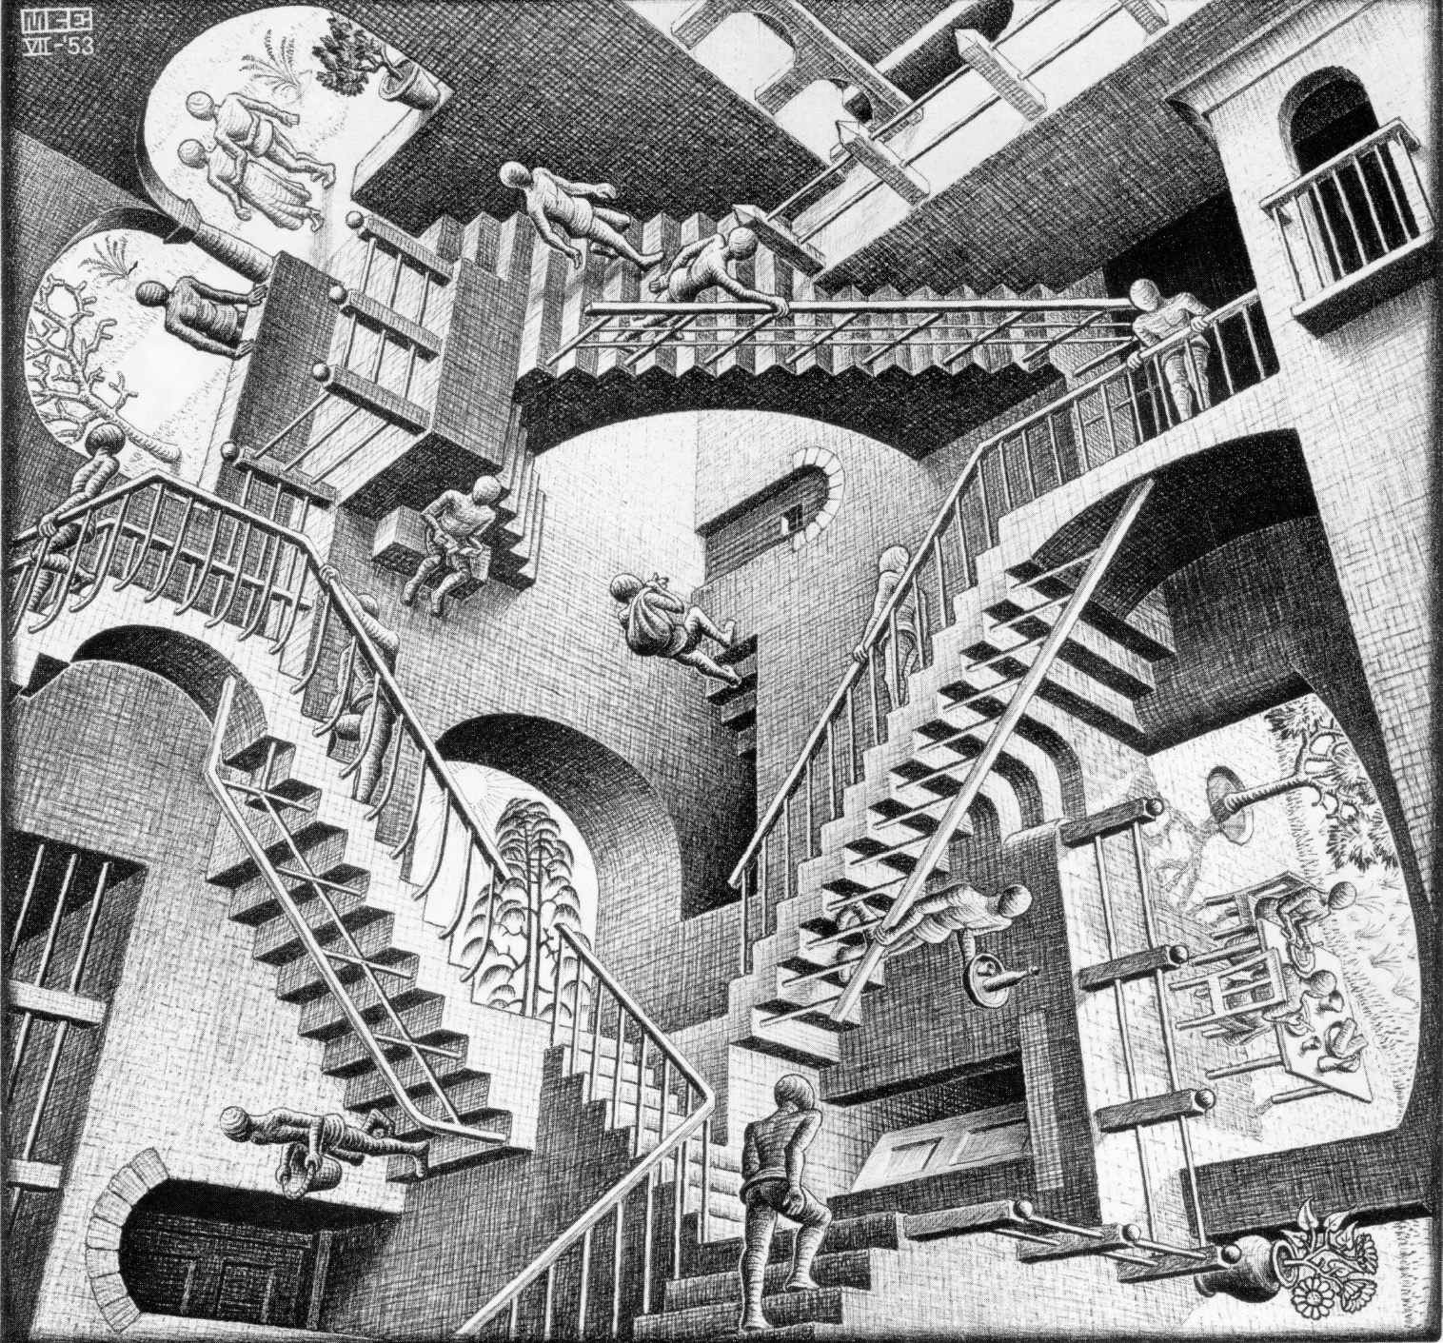
                Put yourself in an unfamiliar but relaxing environment. New environments stimulate new perceptions and ideas.
Put yourself in an unfamiliar but pleasant environment. Newness will jumpstart your creativity.

Slide 42

Get some light exercise just prior to a creativity session. This gets the blood flowing and increases serotonin and dopamine.

Slide 43
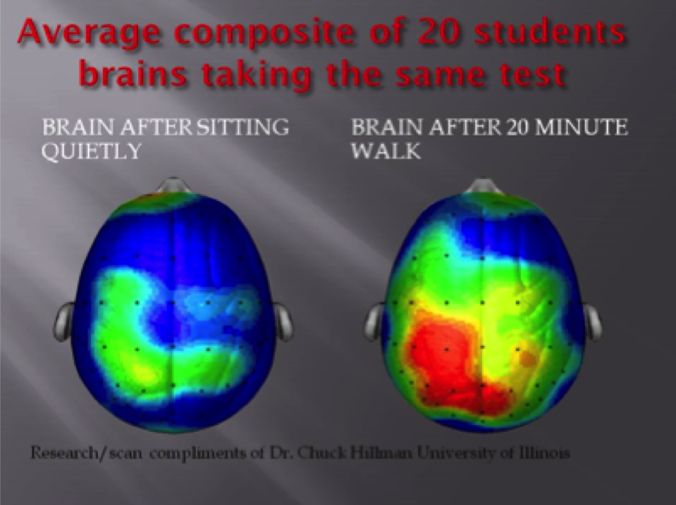

Slide 44

Sing or play a musical instrument briefly to activate the creative right side of the brain.

Slide 45
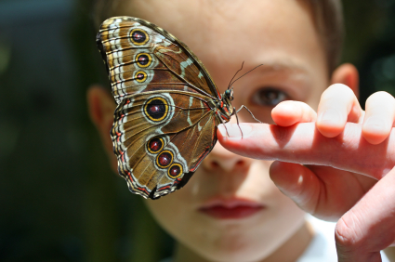


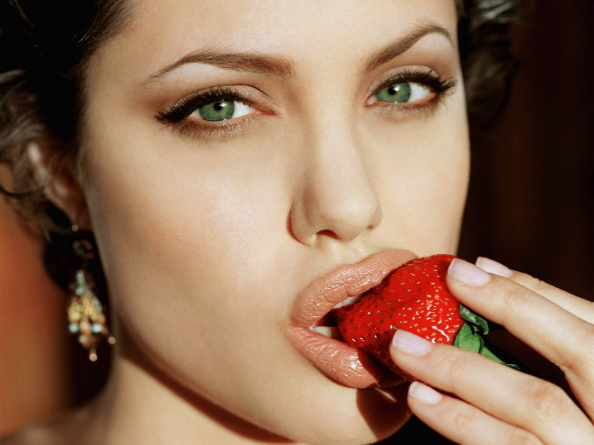
Use sound, fragrance, oral, visual, and tactile senses to stimulate different perceptions and thought processes.

Slide 46

Use meditation, self-hypnosis, or just day dreaming to put your mind into a relaxed, receptive mode for creative ideas.
Remember those alpha and theta waves. This is a good way to generate them while awake.

Slide 47

Put your body into an unusual relationship to gravity and environment by practicing Yoga, Tai Chi, free style dance movement, etc.

Slide 48
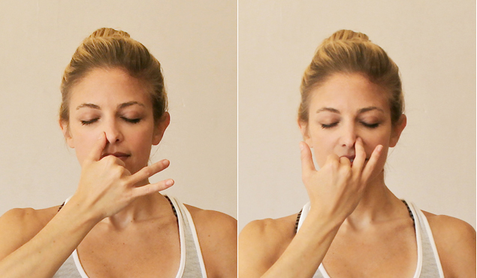
Use breathing exercises to activate both hemispheres of the brain:
  Breath in thru your left nostril and out your right for several minutes, then reverse the process.

Slide 49

  Hold your breath as long as is comfortable so as to raise the carbon dioxide level in your brain. This is refreshing and calming and enhances intuition.

Slide 50

Chewing gum before a creativity session (but not during) will increase blood flow to the brain, thus stimulating the thinking process.

Slide 51
Very Important:
When you are working creatively (or studying or practicing a skill), do so for no more than 90 minutes.
Neuroscientists have found that your brain needs time to rest after mental exertion so as to process the thinking into longer term memory and for continued creative consideration.
So take a break and do something restful and enjoyable after 90 minutes of intense brain work.

Slide 52
90 minute magic!
There is something special about 90 minutes as regards the brain:
The sleeping brain goes thru a 90 minute cycle of different brain waves.
The waking brain needs rest after 90 minutes of focused thinking.

Slide 53
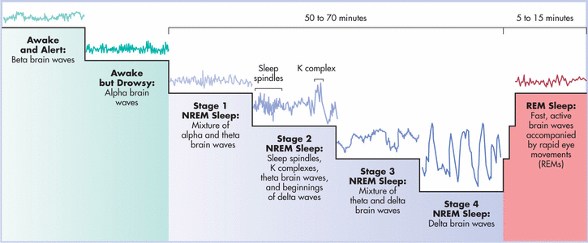
The 90 minute human sleep cycle

Slide 54
Your best strategy for creative work may be to use the 90 minute cycle:
Write for 90 minutes in the morning.
Relax or do something not mind intensive for 20 or 30 minutes.
Do another 90 minute writing session.
Then another 30 minute relaxation session.
Lunch and an afternoon 90 minute nap.
Repeat in the afternoon or evening if you’re really ambitious.

Slide 55
Also Very Important
Creativity is a deliberate act of will.
Using the neuro techniques will prepare you to think creatively.
But they don’t automatically make you more creative.
You must decide to be more creative and put significant conscious effort into your creativity for the techniques to work.

Slide 56
The brain likes to operate on as little energy as possible. That’s why we form habits.
But when we are creative, we are doing something unusual, using more energy.
So we have to force ourselves to be creative.
We have to move our minds out of their ordinary channels.
So when you want to be creative, you have to be very aware of yourself,
and not allow your mind to slip into its ordinary way of functioning.

Slide 57
Now your creativity is activated and you are ready to write. As you write, here are some things to do and to avoid:
  Reject your first thoughts when writing a poem or story.
  The first words that come to mind when thinking about a subject are usually clichés. These are the same words that probably occur to everyone about that subject. Use your right brain to obtain unusual word and idea combinations. Don’t put any restrictions on your thinking. Step away from the cliché.

Slide 58
  Exercise: Visualize a sunset on the ocean or a mountain range. Something familiar.
  Then visualize a sunset as if you are on a moon of Jupiter.
  Which did you find more difficult?
  Visualizing something unfamiliar, which goes completely beyond our experience, requires more imagination, energy, and brain resources.
  But the result is something new, different, original.

Slide 59
Use Forced Association to generate fresh ideas:
Pick a word at random from a dictionary and relate it to the word or idea you are considering. Your mind’s natural pattern seeking will generate a connection. Do this several times to obtain several perspectives on the idea. Then use your left, analytical/ rational brain to consider all the possibilities you’ve generated. Use those that are most interesting or appropriate.

Slide 60
Exercise: Forced Association
“It was a dark and stormy night.”
Force Words from dictionary:
Revised sentence:

Slide 61
  Don’t just describe, transform!
  Many poets are content with just describing an image or situation as exactly or as beautifully as possible. Often this requires skill. But great poems transform the image in some way-- make it extraordinary, magical, and rich with new meaning.
  Allow your right brain to consider extreme metaphors, bizarre images, and outré juxtapositions of words. Stand your idea on its head. Stretch it to its extreme. Turn it inside out. Make it dance.
  Example poem: The Odd Couple

Slide 62
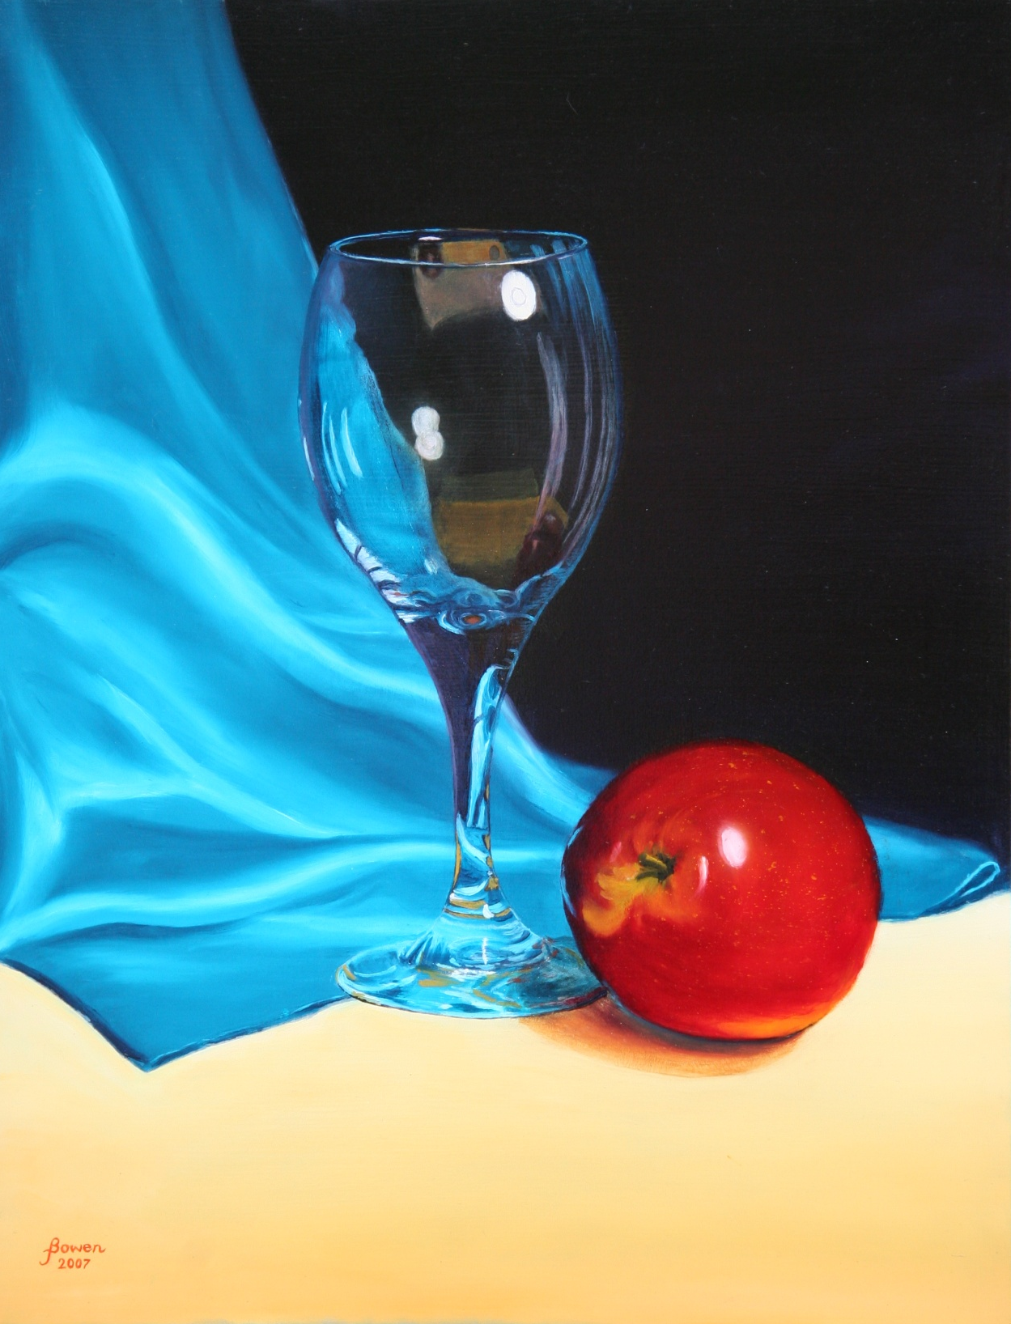

Slide 63
The Odd Couple
She is tall, elegant, sensuously
shapely, exuding a desire
to be held, to be kissed.
She collects the brittle glitter
and excitement surrounding her,
reflecting as bright gossamer
ghosts the images and objects
that seek her.
She is empty of everything but
delight, while he is full of himself:
orotund, opaque, yet radiating
some vast mysterious passion
for becoming he is but barely able
to contain. He has fallen for her,
smitten to the core.
With an empty gravity, she attracts,
refracts, enwraps herself
in an almost royal blue.
He approaches her pedestal,
adoring, worshiping.
And she does not distain him.
She contains him, like a heart,
in the depths of her,
while he is caressed, blessed
by the faint blue blaze
of their osculation.
Never ask how full the glass
nor of the ripeness of the apple.
Michael Baldwin

Slide 64
Infuse the poem with emotion
Build emotion and emotional tension into a poem to increase its impact. Activate your emotional, limbic brain to find the emotional flavor and intensity of the poem (try remembering an emotional situation, viewing an emotion-laden picture, or listening to music that is meaningful for you). Then use your analytical left brain to suggest or imply the emotion rather than stating it too explicitly.
Example poem: Ill Wind
I listened to the oratorio Western Wind
by John Tavener several times while writing this poem.

Slide 65
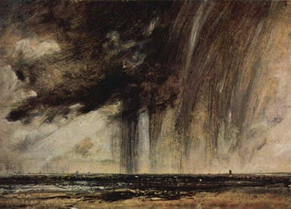
John Constable: Seascape Study With Raincloud

Slide 66
Ill Wind
Gloss on Western Wind
Western wind, when will thou blow
The small rain down can rain?
Christ, if my love were in my arms
And I in my bed again!
Anonymous
Western wind, when will thou blow
to shake the trees from frigid sleep,
to stir to fire my sullen cinders,
to spin my sparks up toward tender,
to flame my soul upon the deep.
Western wind, when will thou blow
the small rain down may rain?
No hands can such small rain hold.
The rain that seeks a root to bless
within the dumb heart’s emptiness.
What unkind prophesy foretold
the small rain down may rain?
Christ, if my love were in my arms
the world would dim to just us two.
But neither wind nor I shall lift her hair,
the rain fall only on despair,
for she is gone to you.
Christ, if my love were in my arms,
and I in my bed again!
My bed that was our universe
cannot now contain my sorrow.
What matter if rain or wind tomorrow?
Now there is only bad and worse,
and I in my bed again!
Michael Baldwin

Slide 67
Be Both Understandable and
Thought-Provoking
Find a middle ground between a poem that’s so simple it’s boring and one that’s so abstruse it can’t be understood (and thus is also boring). A reader/ hearer should be able to get the gist of your poem on first encounter. But the poem should also contain hidden treasure to stimulate reader involvement. This requires both right brain daring and deep left brain creative analysis on the poet’s part.
Example poem: Moondrunk Lunar Eclipse

Slide 68
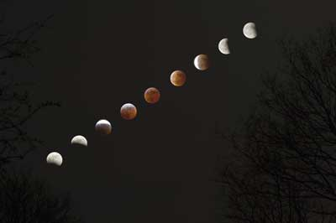
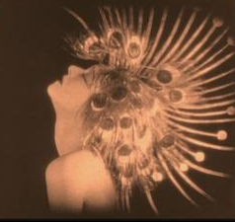


Slide 69
Moondrunk Lunar Eclipse
so we see her shed her last
bright sliver shivering mindless
perhaps not only with the cold
nothing more shiverous than moonmind
then slowly she hurtles
homeless as a god-thrown stone
lost on her always falling circle
nothing more homeless than moonlost
and we stagger blindly back inside
only to find her stranded in the television
wonder-wounded
nothing more
Michael Baldwin
nothing more naked than moonlight
she dances Salome’s solemn bacchanal
upon the wine-dark night while
we and the stars drown moondrunk
nothing more drunk than moondrowned
while we prattle on of
stock picks politics jazz licks
until brightness fails as she unveils
and blushes with shadowed innocence
nothing more innocent than moonblush
yet as she unmirrors the sun
and echos earth’s lesser lumination
could love thus reflect if only in eclipse
nothing more reflective than moonlove

Slide 70
  Surprise! And Humor are Good.
The right brain enjoys creating and experiencing humor and surprise thru unexpected combinations of words and ideas. It’s okay to bend or break the rules of language if you show you know the rules and have violated them for a valid poetic purpose.
Example poem: Poetry Insurgency

Slide 71

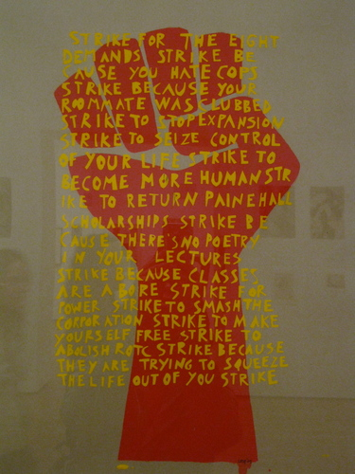




Poetry
Insurgency

Slide 72
Poetry Insurgency
by Michael Baldwin
  Have you heard about the new wave of terrorism
  that’s sweeping the country?
  Let me read you some of these news briefs:
  Poetry terrorists detonated a powerful Sestina
  near the White House yesterday,
  resulting in damage to numerous
  inflated egos and supercilious attitudes
  among high government officials.
  Poetry insurgents also infiltrated a political rally recently
  and pummeled the crowd with sonnets, ballads, and elegies.
  One witness said it was a Pindaric Ode
  that really enflamed the crowd.
  Poetry terrorism has become so egregious in some cities
  that authorities have resorted to poetry-sniffing dogs,
  hoping to find poets before they can recite to mass audiences.
  Nevertheless, officials can’t deny that the situation
  is getting verse and verse.

Slide 73
  In fact, poets actually took over a local television station,
  then subjected thousands of unsuspecting viewers
  to some vicious Iambic Pentameter.
  Before police could arrive, the terrorists even exposed
  their Ars Poetica.
  Another gang of poets hi-jacked a city bus
  and forced the driver to take them into the country
  to watch some woods fill up with snow.
  They regaled the passengers with nature poetry
  for several hours. The bus was allowed to return without harm.
  But one of the passengers interviewed said
  “I didn’t understand that poem about the 13 black birds.
  I may quit my Wall Street job and go back to college for an MFA.”
  The chief of the Special Anti-Poetry Squad
  asserted that his team is exerting every effort
  to apprehend these renegade literati.
  “Many of them are just amateur alliterators--- mere Anapests.
  But there are also some really dangerous poets out there
  and the police can’t do much when the terrorists have
  all that Free Verse to work with.

Slide 74
Sometimes they only fire Blank Verse, just to lull you into complacency.
Then, just when you think you have them,
they jump you with some strange enjambment,
pop you with a Pantoum, or stun you
with a stroph of Terza Rima.
If they come at you with that high caliber Elliot or Plath,
you just don’t stand a chance.”
The President, addressing the nation about poetry terrorism,
stated that if the public gives in to either rhyme or reason,
the poets will win. He vowed to stay the course,
to keep the country from becoming a poetocracy.
He also announced that the US Poet Laureate had been arrested
and shipped to Guantanamo for interrogation.
The President assured the public that, quote,
“Our overwhelming capacity for propaganda
and our weapons of mass deconstruction
will soon rid us of these Villanelles.”

Slide 75
    However, one highly-placed government source
    who wished to remain anonymous, admitted that
    “A growing segment of the public is coming to believe
    ‘beauty is truth, and truth beauty--- that is all
    you know on earth and all you need to know.’
    God help us if the majority of Americans
    actually start demanding truth and beauty.”

Slide 76

That is briefly what neuroscience has to say about creativity at this point in time.

Slide 77
We said at the beginning of this presentation that at least 95% of thought is subconscious.
That is where mysticism comes in.
Mystics have been exploring the subconscious mind for thousands of years, using non-scientific but highly disciplined techniques to directly experience sub-conscious reality.
In recent times psychology has explored and verified many of the beliefs of traditional mysticism.
Marilyn will now present some of the ideas and techniques of mysticism that may help you become more creative.

Slide 78
Part Two
Open yourself To
USING MYSTICISM
As A Creative Tool
By
Marilyn Gilbert Komechak, PhD

Slide 79
What Is Mysticism?
Mysticism is the deliberate, objective exploration of the subconscious mind thru direct mental experience.
Some have termed it “Internal Empiricism,” in contrast to the “External Empiricism” of science.
This direct experience can be attained in many ways:
reverie, meditation, trance, hypnosis, spiritual ecstasy, drugs and hallucinogens, mindfulness training, etc.
Some of these techniques obviously can be dangerous.
But they can also lead to mystical and spiritual insight and to enhanced creativity as the right-brain hemisphere allows us to experience some of that 95% of mental activity of which we usually unaware.

Slide 80
Mysticism and Neuro-science
Creative people often have “mystical” experiences.
Mystics have been experimenting with the mind for thousands of years.
Many of the findings of neuroscience are proving what mystics have said about the mind.
But the techniques of neuroscience provide a better basis for understanding the mind.

Slide 81

The battle between heart and mind

Slide 82
Our hands can tell us if we are dominant in left or right brain.

Slide 83
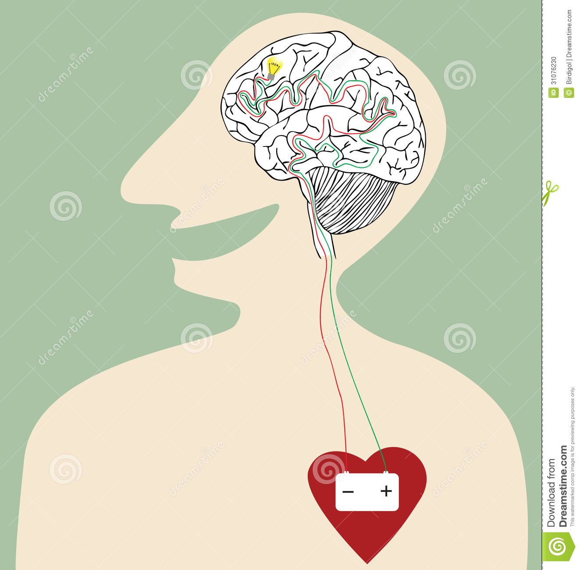
The Heart—Mind Connection

Slide 84


Slide 85
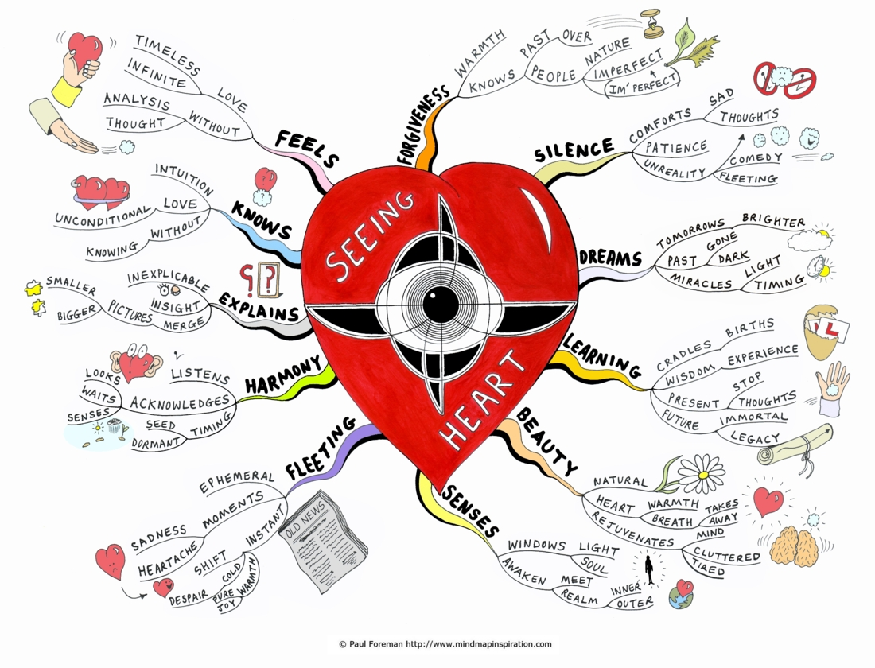
The heart sends more messages to the brain than it receives from the brain.
The heart often knows before the brain knows.

Slide 86

Ice crystals on an aircraft window
Photo by K. Susan Nanna

Slide 87


“Write the poem so it slides through the brain and goes straight to the heart.” Maya Angelou

Slide 88

The memories of long love gather like drifting snow,
Poignant as the mandarin ducks,
Who float side by side in sleep.
Geji

Slide 89

85% of us have heart walls to protect from hurtful emotions

Slide 90


Slide 91


Slide 92
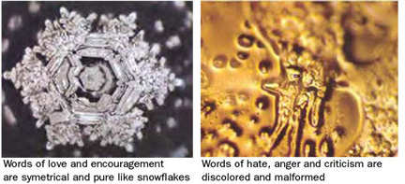
Water crystallization experiments by Masaru Emoto

Slide 93
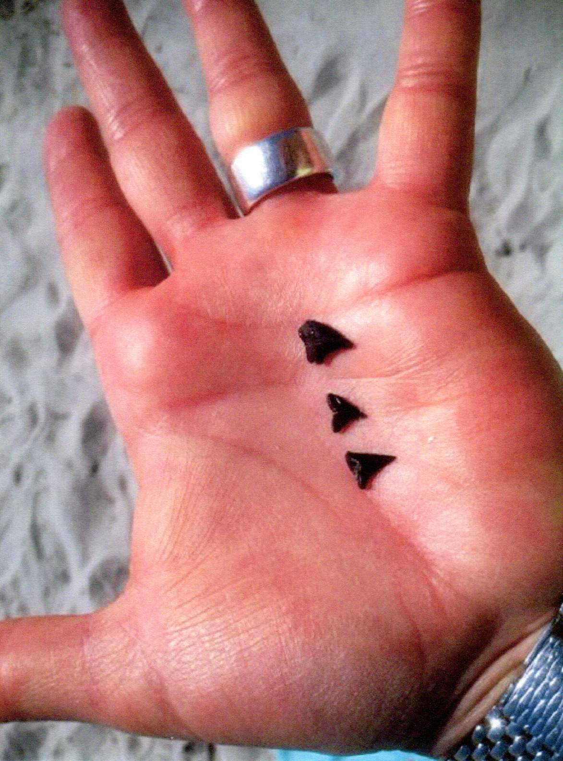

Slide 94
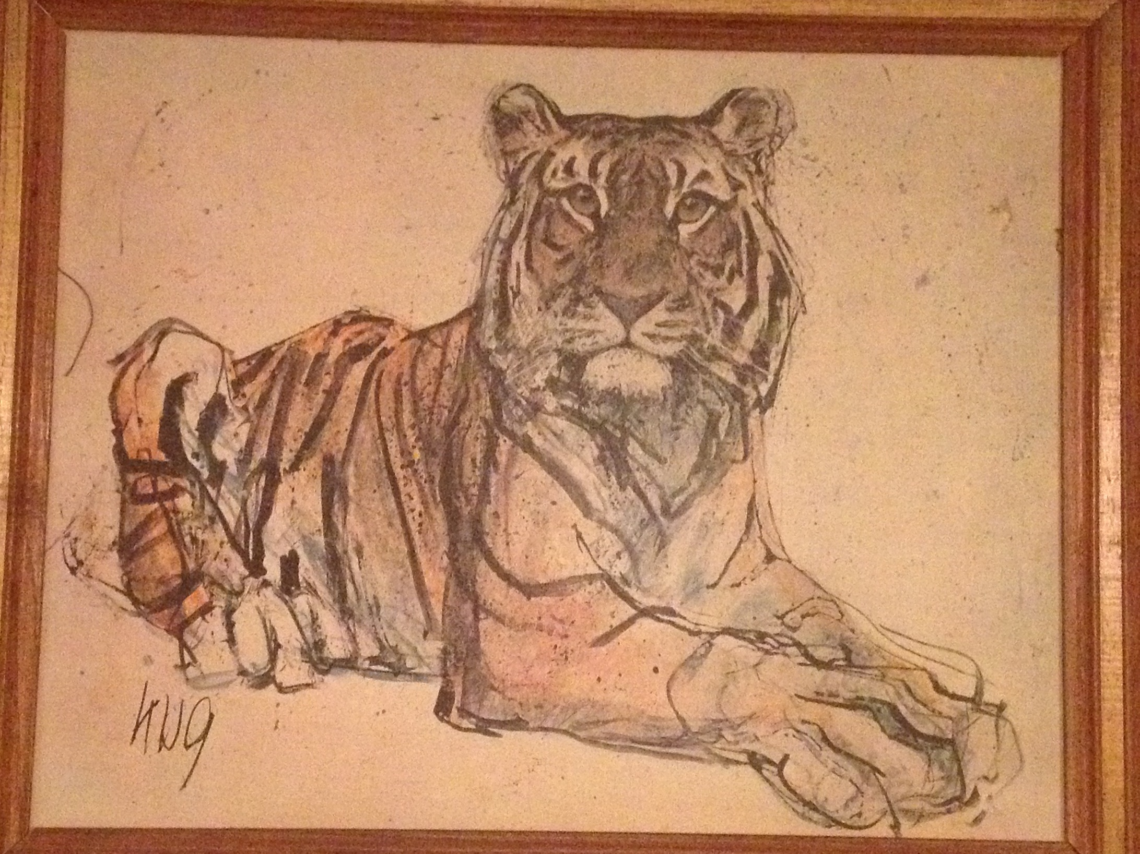

Slide 95

When dancing in the dark, trust your subconscious to lead

Slide 96


Slide 97

The mystic’s quest to penetrate beyond ordinary reality

Slide 98

There is a basket of bread on your head, yet you go door to door asking for crusts. Knock on your inner door—no other! Rumi

Slide 99
Thank you for your participation in this workshop! Contact us any time if you have questions about how to apply the techniques we’ve discussed to your creative writing.
Mike Baldwin can be emailed at:
librmike@hotmail.com.
Marilyn Komechak can be emailed at: skydancerspen@flash.net.

Slide 100
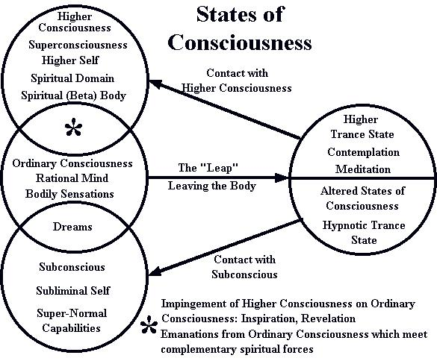

Slide 101
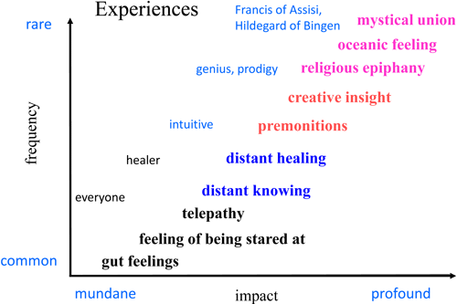

Slide 102
Creative Thinking In All Areas Of Our Lives
We can benefit from using our creative minds even when we are not doing art.
Everyday decision-making can be made more effective if we activate our creative minds.
Life becomes more interesting, more enjoyable, and more satisfying when we take a creative approach to living.
Sometimes it takes courage to think creatively when there is pressure to agree with the group or to not question the popular viewpoint.

Slide 103
So I urge you to activate your creative mind everyday in every aspect of your life.
Remember to question your assumptions.
Challenge your usual way of doing things.
Actively look for alternative explanations and possibilities.
Don’t limit yourself to what you consider “realistic” or “practical” when working on a problem.
Creative thinking combines your left brain critical mind with your right brain imagination.
Creative thinking occurs both inside and outside the box.
You don’t have to be a genius to think creatively.
Creativity is both effective and beautiful.

Slide 104
Summary of Neuroscience Techniques For Stimulating Creativity:
You can promote the production of neurotransmitters serotonin and dopamine in several ways:
Reduce stress as much as possible. Stress produces cortisol, which reduces serotonin and dopamine.
Get 6 to 8 hours of high quality, deep sleep. This helps generate serotonin, which will then be highest in the morning.
Because serotonin is highest in morning hours, that’s the best time to do your creative work.
Eat a high-protein breakfast rather than carbohydrates. Protein helps produce both serotonin and dopamine.
Stimulate serotonin production and energy thru physical exercise and perhaps the mild stimulant of coffee or tea.
Although serotonin & dopamine may be naturally high in the morning, you may want to be more creative in afternoon or evening. Anytime is good for creativity if you can free yourself from stress, be relaxed but alert, and are ready to be creative. Here are some additional things you can do to prepare for creativity:

Slide 105
6. Put yourself in an unfamiliar but relaxing environment. New environments stimulate new perceptions and ideas.
7. Get some light exercise just prior to a creativity session. This gets the blood flowing and increases serotonin and dopamine.
8. Use sound, fragrance, oral, visual, and tactile senses to stimulate different perceptions and thought processes.
9. Use meditation, self-hypnosis, or just day dreaming to put your mind into a relaxed, receptive (alpha/theta wave) mode for creative ideas.
10. Put your body into an unusual relationship to gravity and environment by practicing Yoga, Tai Chi, free style dance movement, etc.
Sing or play a musical instrument briefly to activate the right side of the brain.
Use breathing exercises to activate both hemispheres of the brain:
  A. Breath in thru your left nostril and out your right for several minutes, then reverse the process.
  Hold your breath as long as is comfortable so as to raise the carbon dioxide level in your brain. This is refreshing and calming and enhances intuition
13. When you are working creatively (or studying or practicing a skill), do so for no more than 90 minutes, then take a 20 minute rest.

Slide 106
14. When writing:
  A. Reject your first thoughts when writing a poem.
  B. Use Forced Association to generate fresh ideas. Use a dictionary to find words at random and let those words give you new ideas.
  C. Don’t just describe, transform! Transform the image in some way-- make it extraordinary, magical, and rich with new meaning. Consider extreme metaphors, bizarre images, and outré juxtapositions of words. Stand your idea on its head. Stretch it to its extreme. Turn it inside out. Make it dance.
  D. Infuse the poem with emotion by activating your limbic brain with remembered emotion, music, images, etc.
  E. Be Both Understandable and Thought-Provoking
  F. Surprise! And Humor are Good.

Slide 107
I want your feedback about this workshop.
Were the ideas presented clearly enough for you to understand them?
Were you able to use the ideas effectively?
Were the example poems effective in illustrating the techniques?
What are your suggestions for improving the presentation?
Other comments on the workshop.

Slide 108
Thank you for your participation in this workshop! Contact me any time if you have questions about how to apply the techniques we’ve discussed to your creativity.
Mike Baldwin can be emailed at: librmike@hotmail.com.

